Slide 1
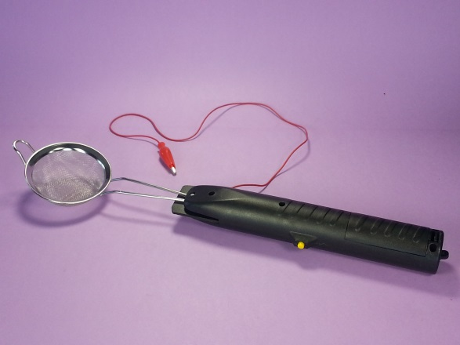
MAKING & USING A STATIC GRASS APPLICATOR
Bruce Bowie

Slide 2
THIS CLINIC WILL REVIEW THE FOLLOWING:
Materials
Costs
Recommended Tools
Disassembly
Modifications
Wiring
Re-assembly
Examples from the Lake Erie & Cold Creek
Buy or Build??
Demonstration w/ Tips & Tricks

Slide 3
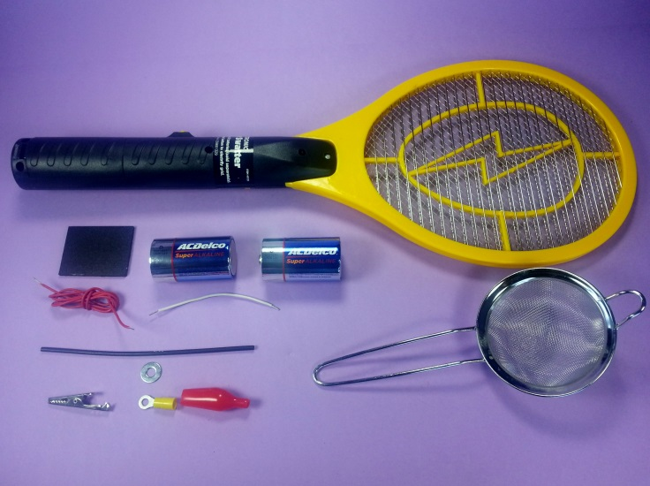
MATERIALS
Sources
Electronic Fly Swatter
Harbor Freight, Ebay, Amazon
Small Metal Kitchen Strainer
Ollie’s, Dollar General, Drug Stores
(2) D Cell Batteries
Anywhere
Insulated Alligator Clip
Radio Shack, Big Box Home Improvement Stores, Ace Hardware
18-20 Ga. Stranded Wire
Radio Shack, Big Box Home Improvement Stores, Ace Hardware
1/8” x 1 ½” x 2” Plastic or Wood Spacer
Big Box Home Improvement Stores, Ace Hardware, Craft Store
3/32 Shrink Tubing
Radio Shack, Big Box Home Improvement Stores, Ace Hardware
3/16 Steel Washer
Big Box Home Improvement Stores, Ace Hardware

Slide 4
costs
Well Below $10 including batteries
Electronic Fly Swatter
$3.49 - $7.50
Small Metal Kitchen Strainer
$1 - $1.50
(2) D Cell Batteries
$2
Insulated Alligator Clip
$0.35
3/32 Shrink Tubing
$ Minimal
20 Ga. Stranded Wire
$ Minimal
1/8” x 1 ½” x 2” Plastic or Wood Spacer
$ Minimal
3/16 Steel Washer
$ Minimal

Slide 5
TOOLS
20-40 Watt Soldering Iron
Soldering Flux
Rosin Core Soldering Paste
Alligator clamps or other clamps to act as heat sinks
Wire Cutters
Wire Strippers
Crimpers
#1 Phillips Screwdriver
Medium Straight Screwdriver
Permanent Marker

Slide 6
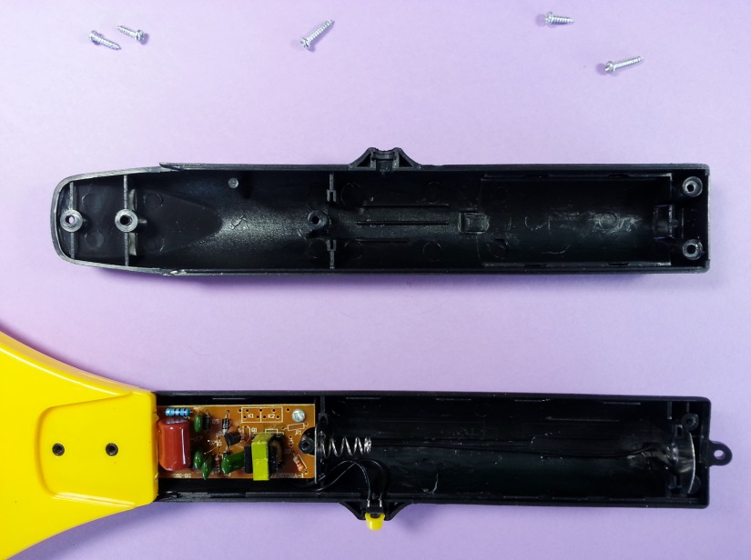
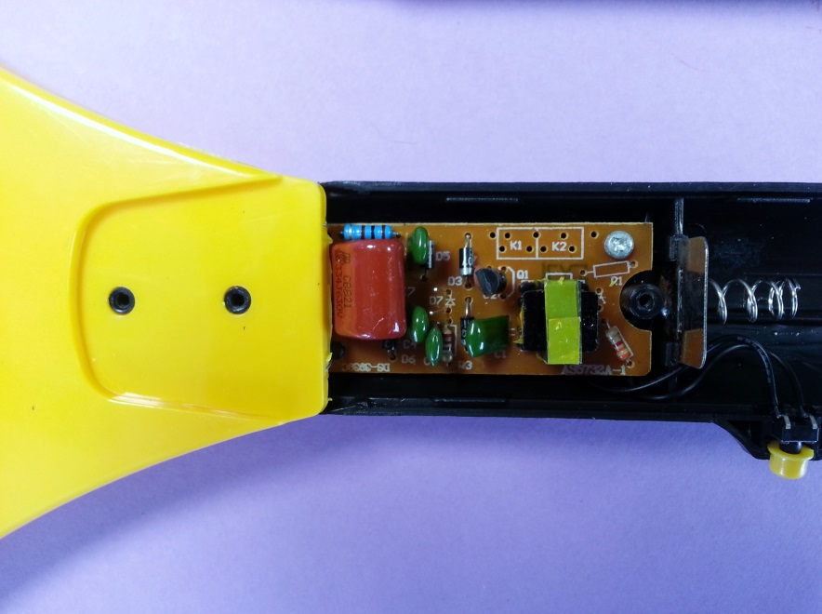
DISASSEMBLY
Remove screws holding handle together and separate top half of handle, leaving head and lower half of handle together.

Slide 7
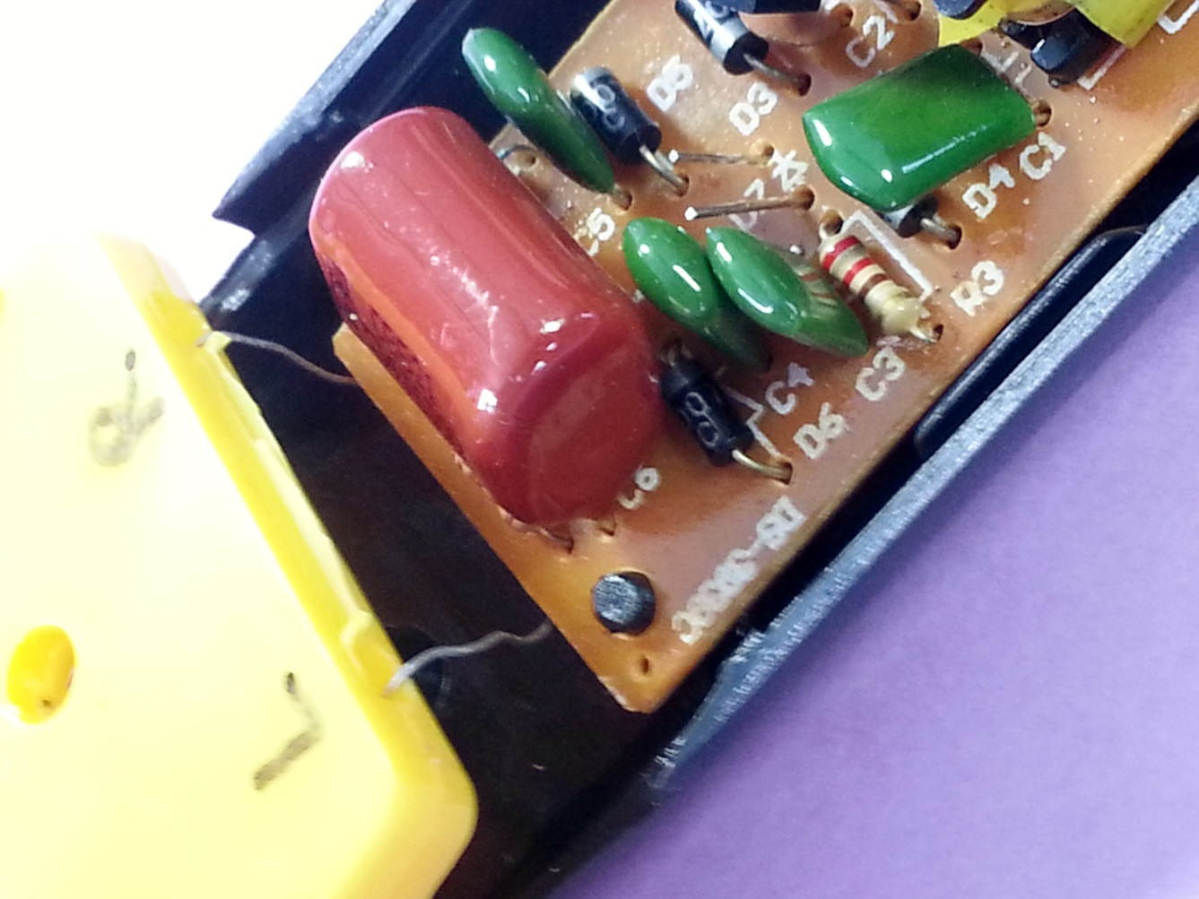
DISASSEMBLY
Gently pull head loose from lower handle, then using permanent marker, mark head for LEFT and RIGHT where wires enter head

Slide 8
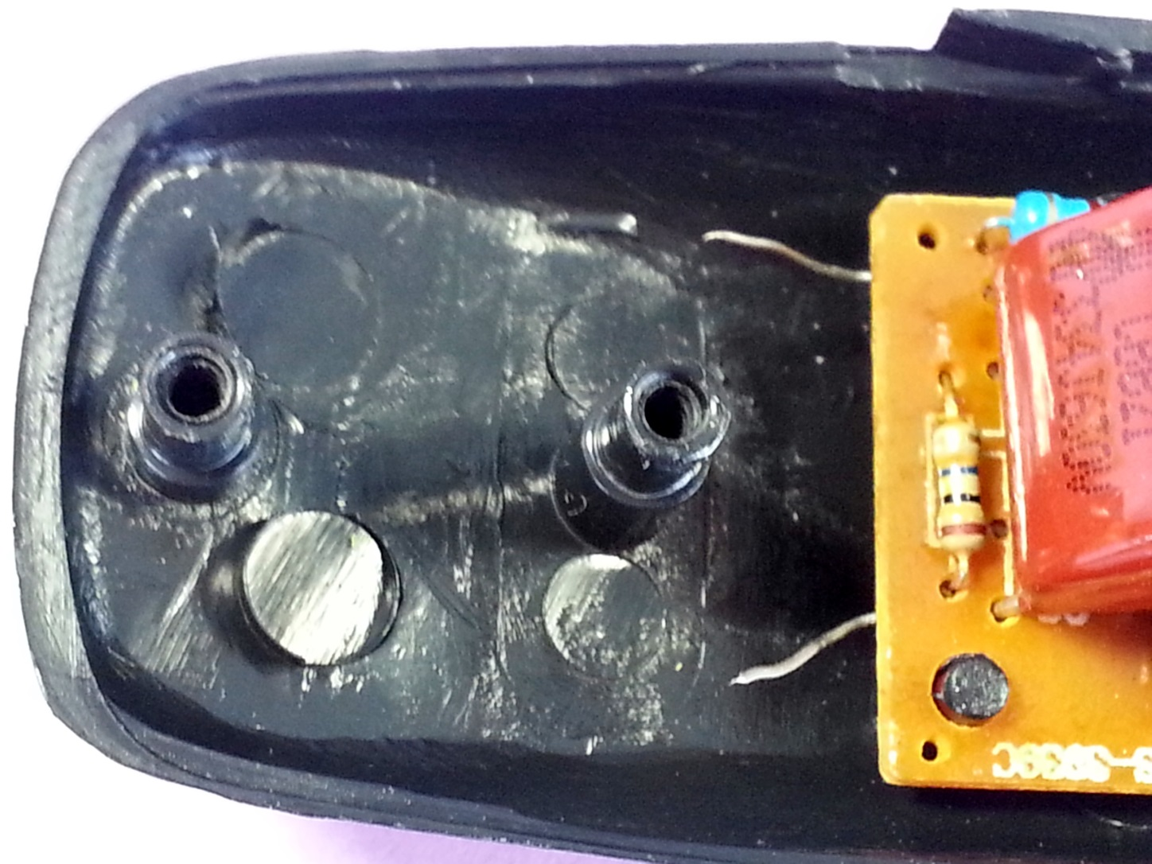
DISASSEMBLY
Trim the two wires close to the head. These two wires will be used to connect the new leads later on.

Slide 9
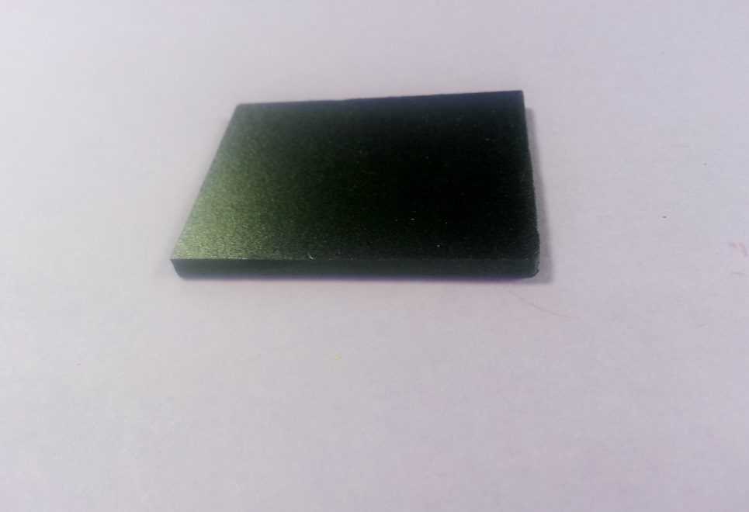
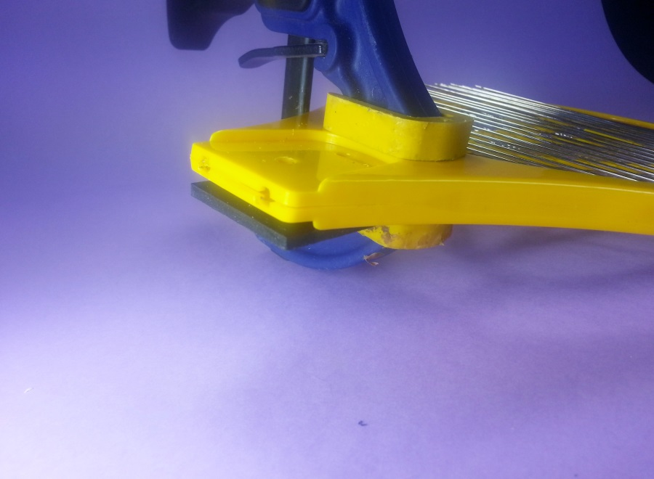
modification
Clamp 1/8” thick plastic or wood spacer to the head.

Slide 10
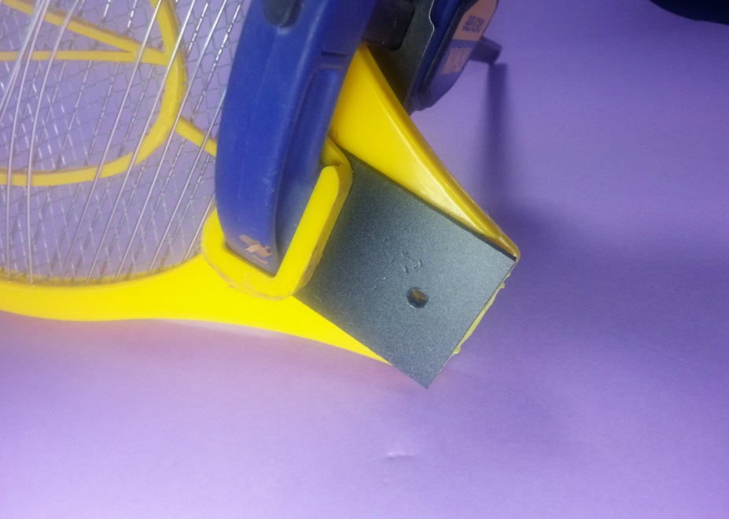
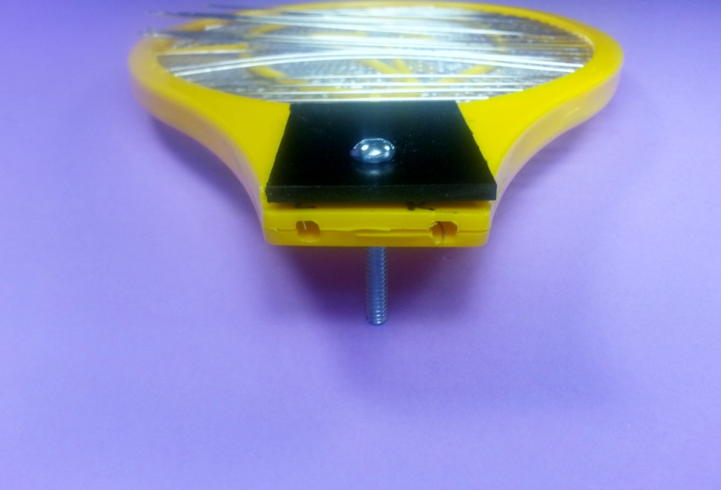
modification
Drill 1st hole using existing hole in head as a guide, insert bolt and nut in 1st hole, then drill second hole again using existing hole as a guide.

Slide 11
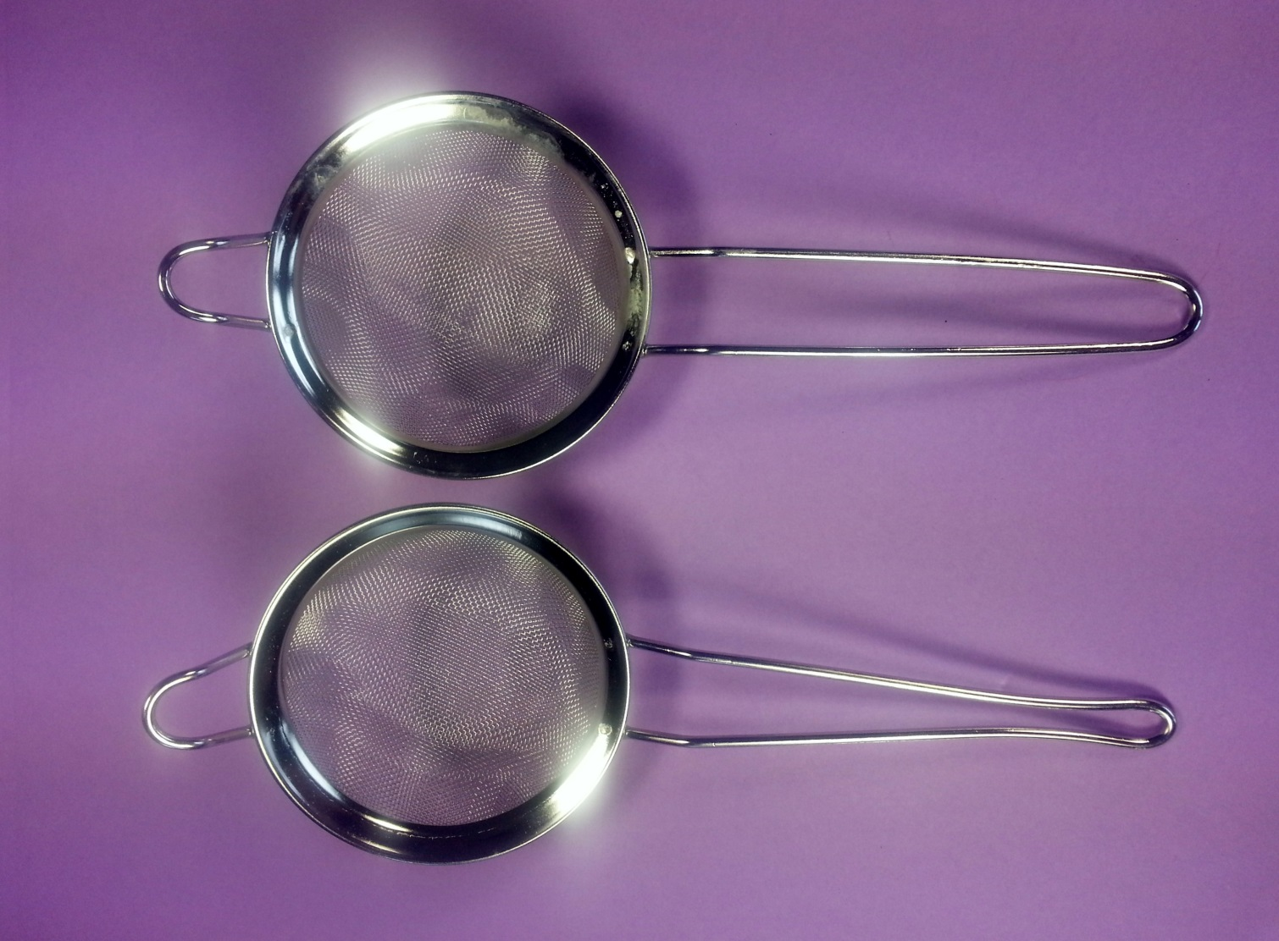
modification
Squeeze strainer handle until inside dimension matches posts inside bottom handle (approximately 3/16”).

Slide 12
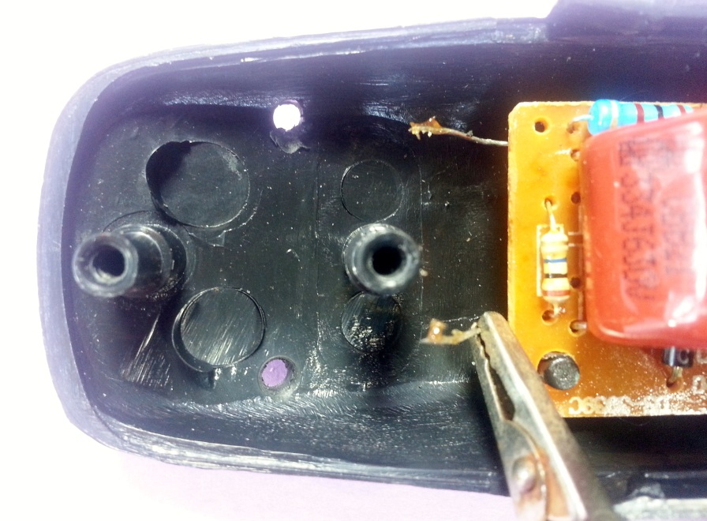
wiring
Flux and tin the two wires making sure to use a heat sink between the area being tinned and the end connected to the board.

Slide 13
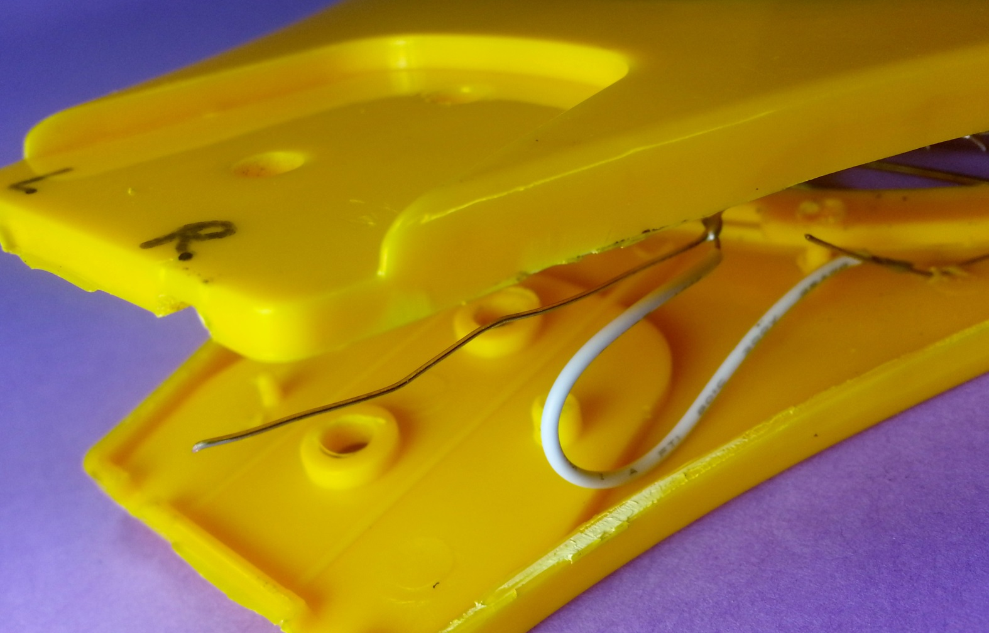
wiring
Remember marking the head prior to cutting the wires? Use a flat bladed screwdriver to open the head. See which wire goes to the inner fine mesh and which goes to the two outer meshes.

Slide 14
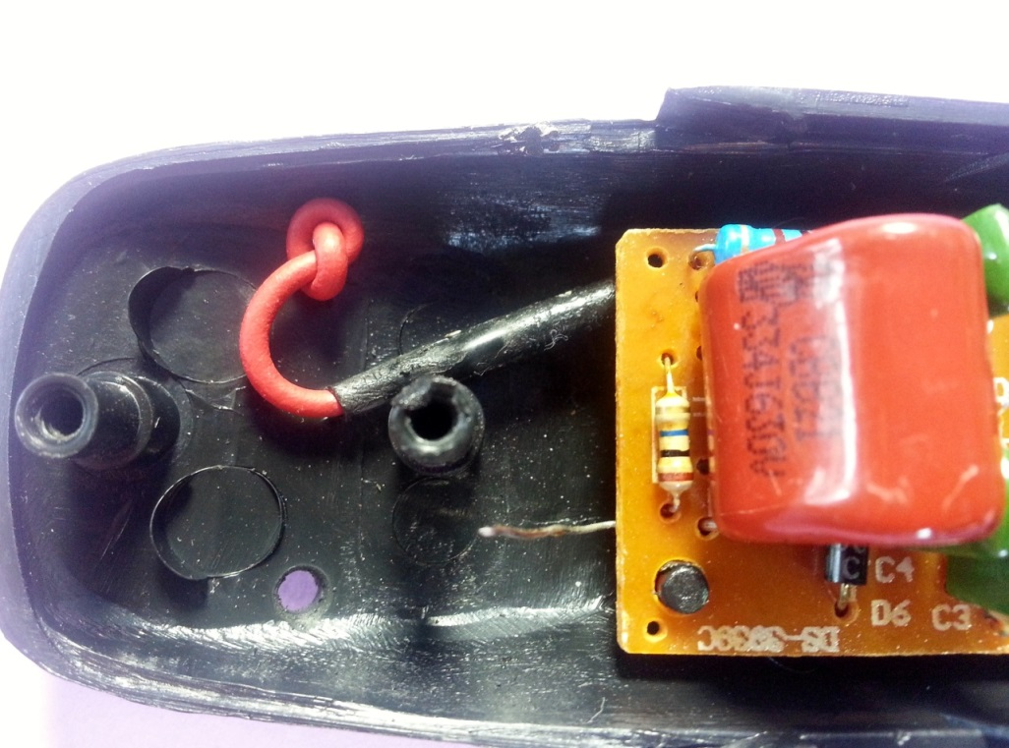
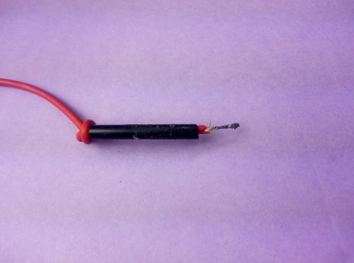
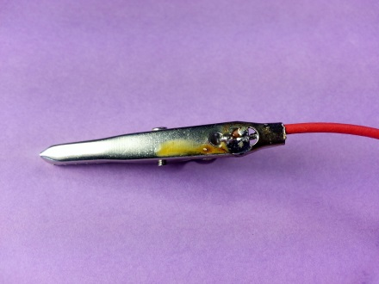
wiring
Now with heat sink still in place, solder the long wire to the wire originally connected to the outer meshes. Use heat shrink tubing to protect the connection. Drill a 3/32” hole in line with the long wire. Tie a knot to act as a strain relief, then push wire through previously drilled hole. Solder an insulated alligator clip to the other end of the long wire, remembering to put the flexible insulator on the wire first (not pictured…guess why)!

Slide 15
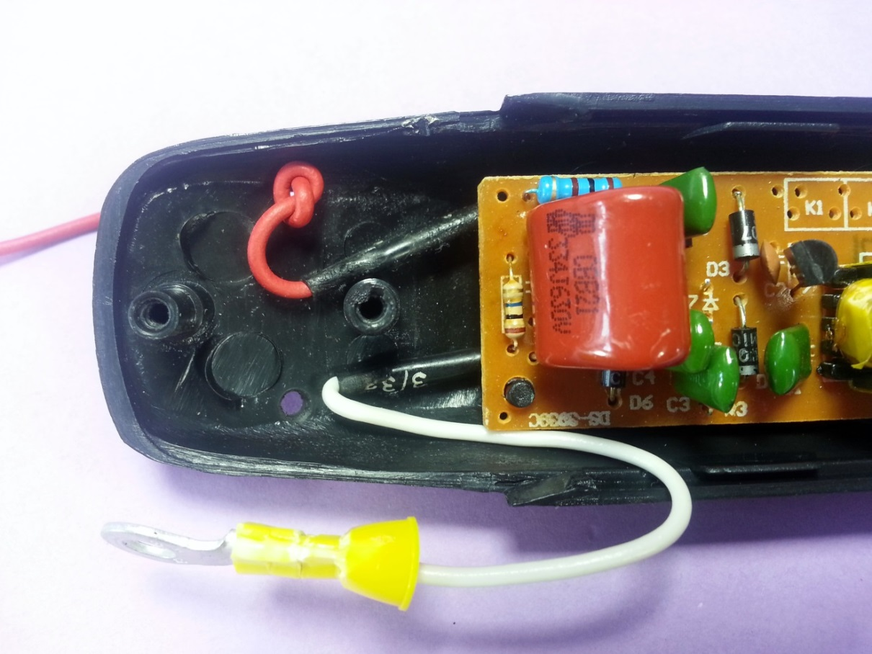
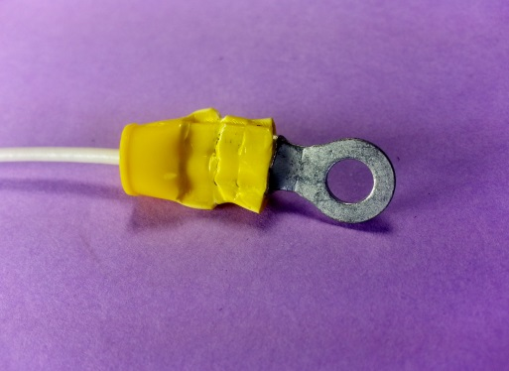
wiring
Crimp a ring connector to one end of the short wire. Crimp connector should have a bolt hole large enough to allow it to fit over the mounting post. Again with a heat sink and shrink tubing in place, solder the short wire to the wire connected to the inner fine mesh.
It is also possible to solder this wire directly to the steel strainer handle.by first filing off the plated surface.

Slide 16
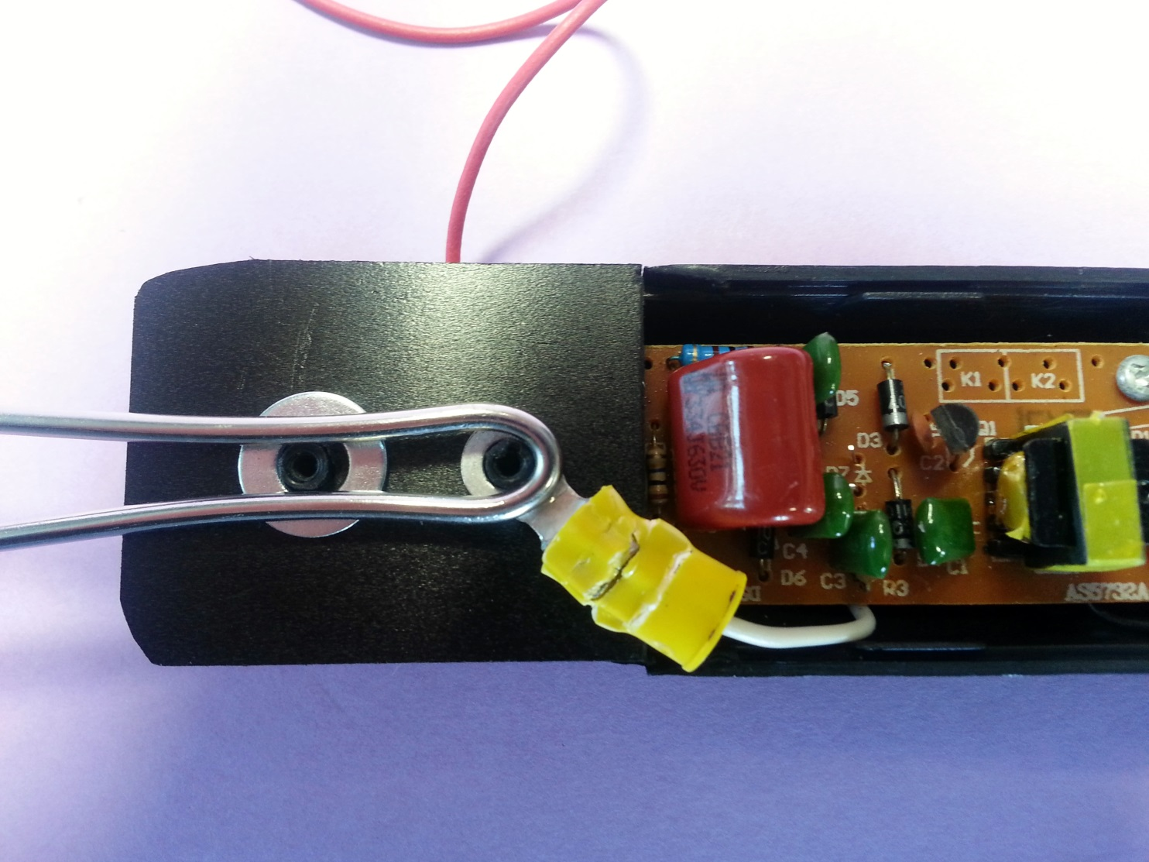
assembly
Put a steel washer on one post and the crimped connector on the other post. Holding the strainer as shown, put the handle together and secure with the original screws. The washers help ensure the strainer is held firmly in place when the unit is assembled. I have also successfully solder the wire directly to the steel strainer handle after filing the plated coating off.

Slide 17
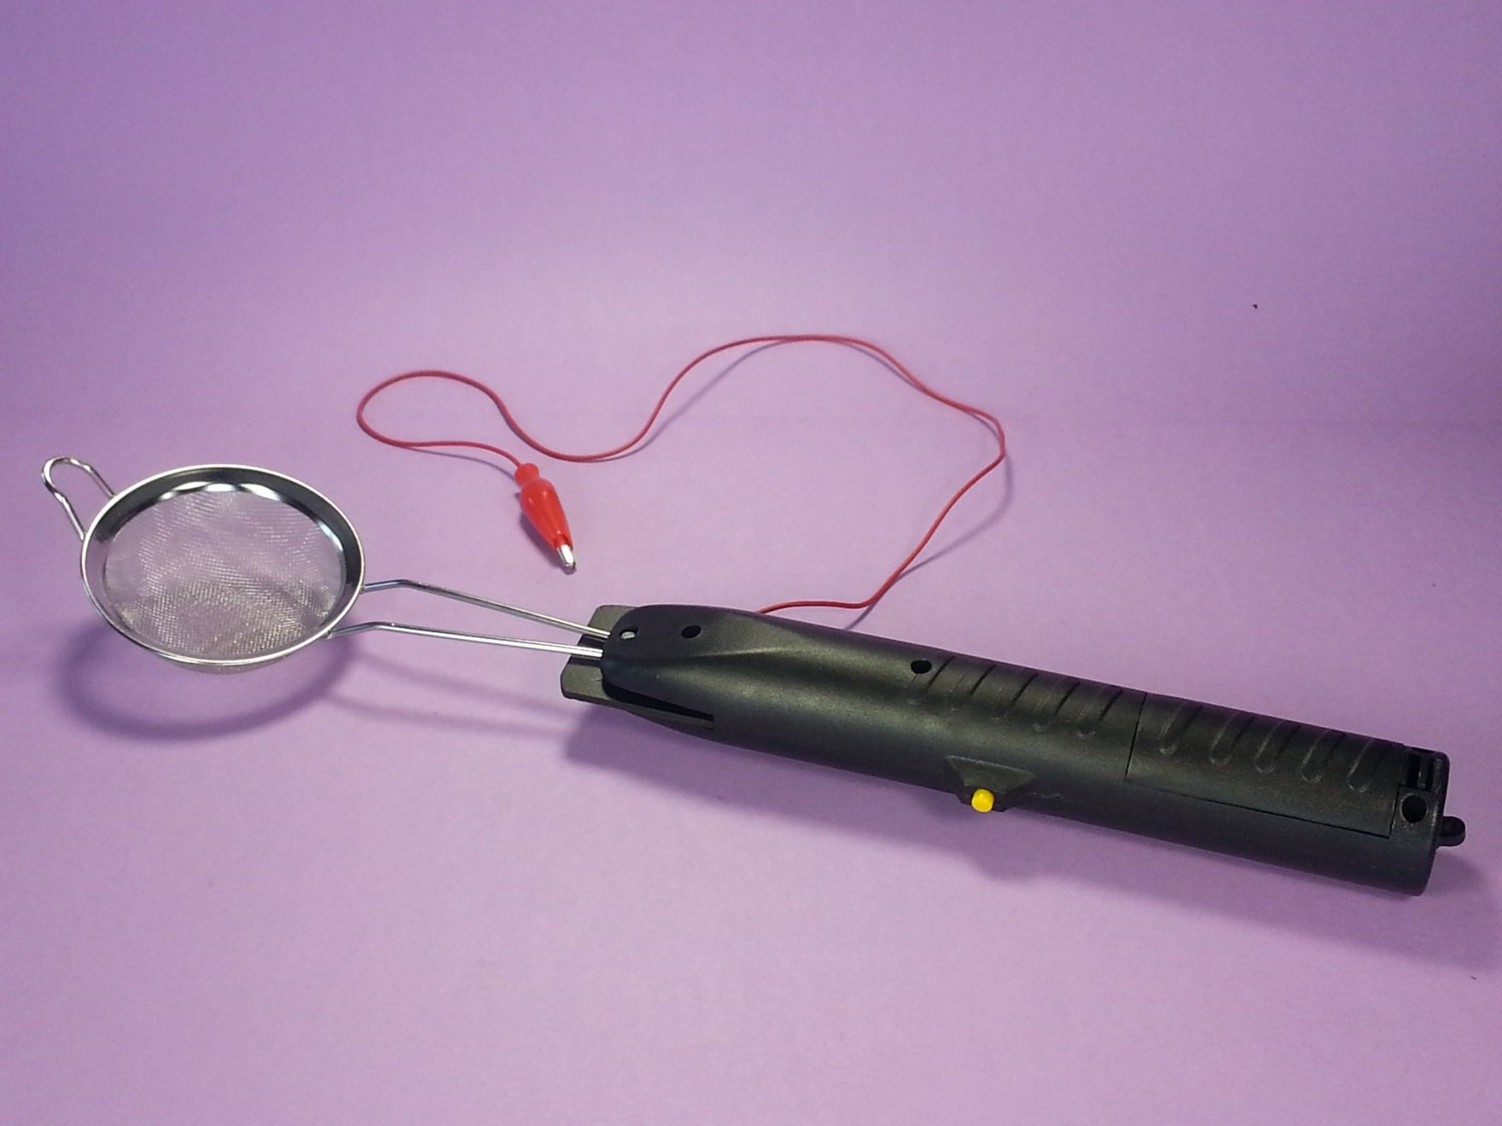
DONE!

Slide 18
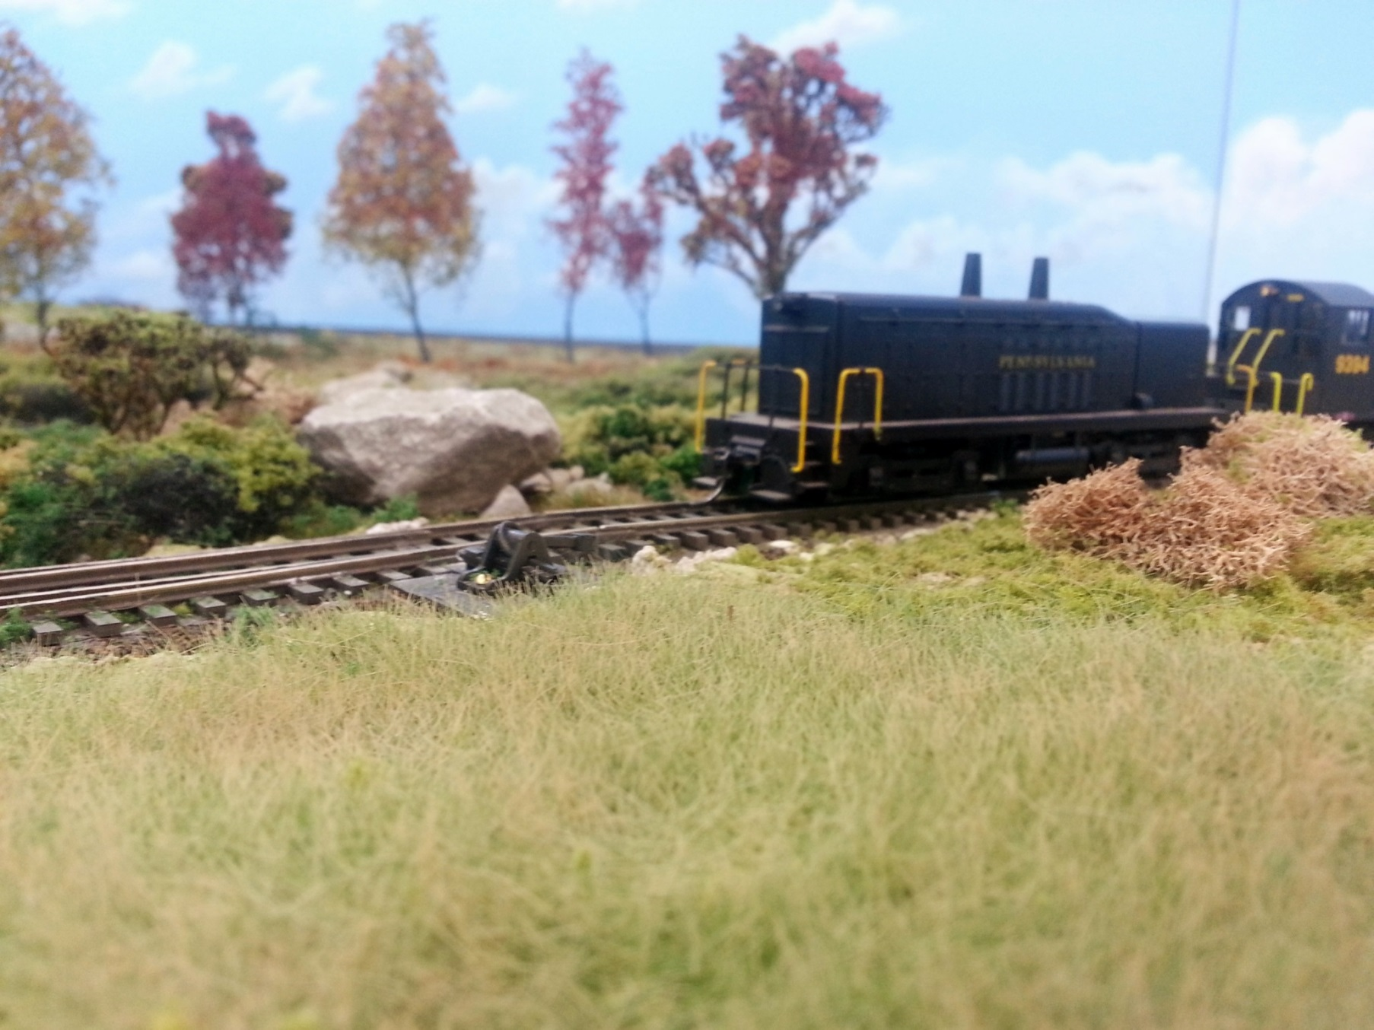
LAKE ERIE & COLD CREEK RAILROAD by JIM MOORE

Slide 19
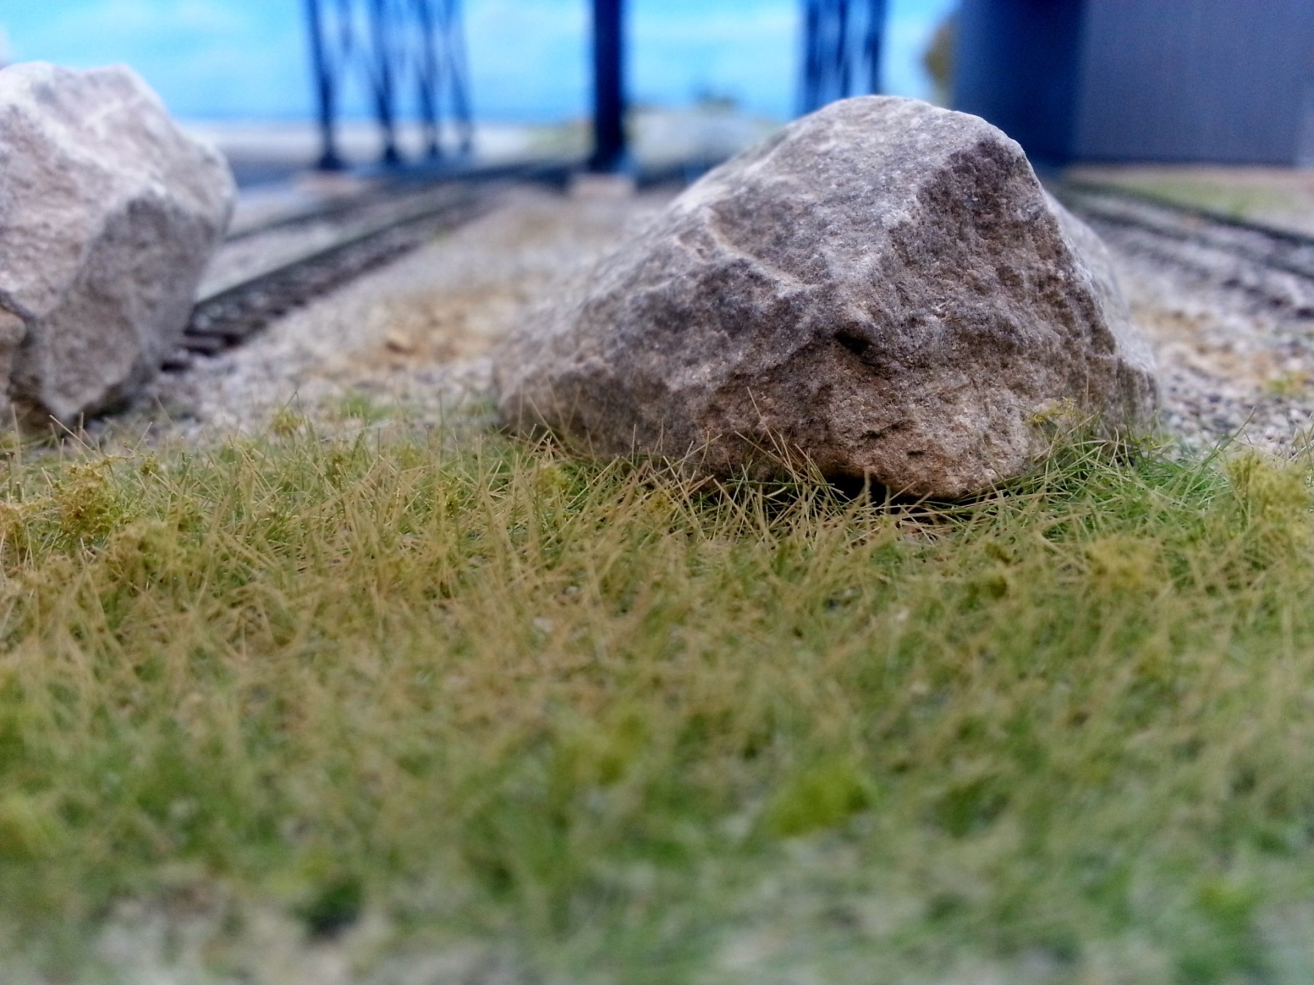
LAKE ERIE & COLD CREEK RAILROAD by JIM MOORE

Slide 20
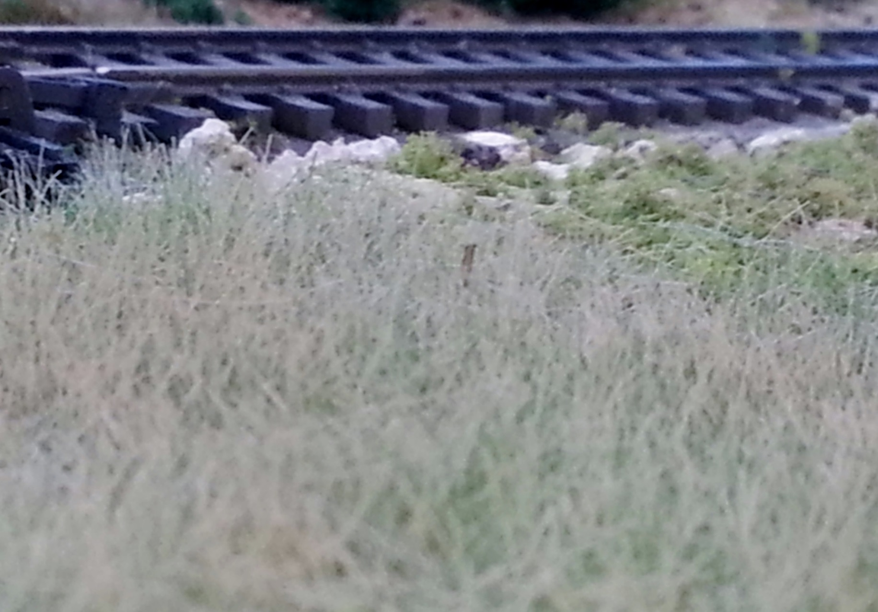
LAKE ERIE & COLD CREEK RAILROAD by JIM MOORE

Slide 21
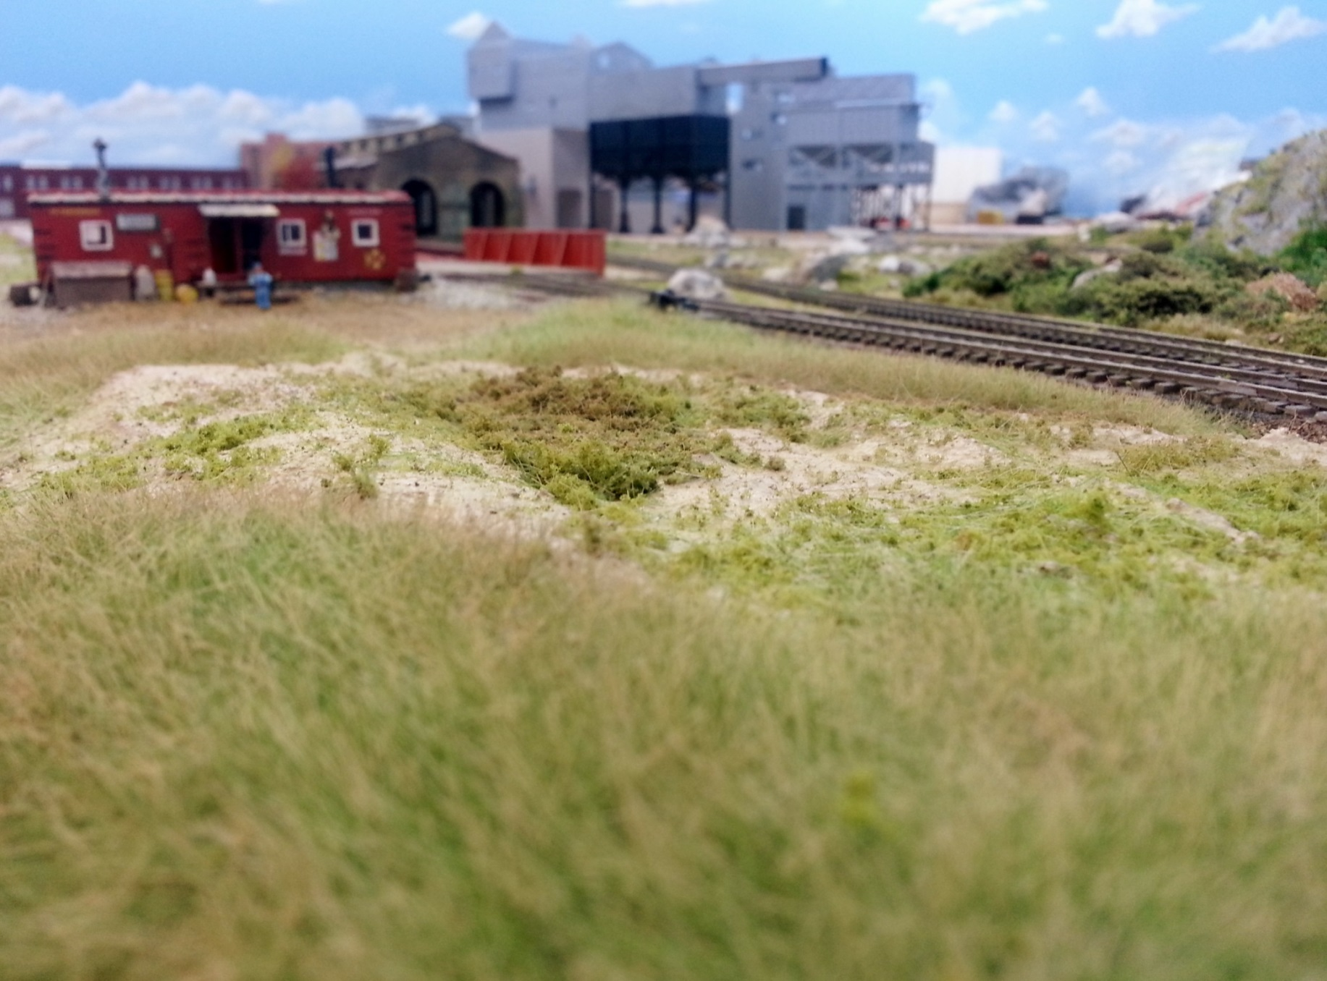
LAKE ERIE & COLD CREEK RAILROAD by JIM MOORE

Slide 22
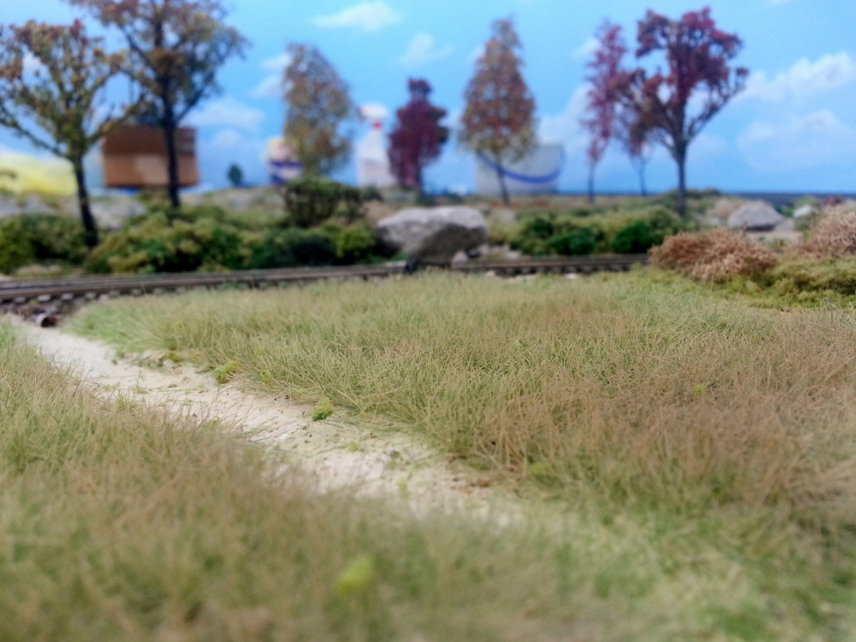
LAKE ERIE & COLD CREEK RAILROAD by JIM MOORE

Slide 23
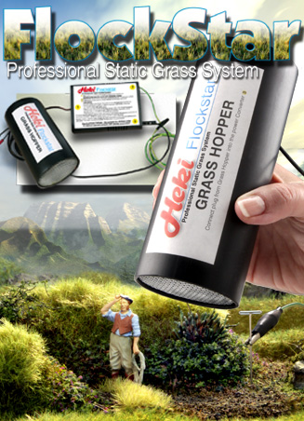
Buy OR build??
SCENIC EXPRESS
FLOCKSTAR PROFESSIONAL STATIC GRASS SYSTEM
Item Number: HK9500
Unit Price: $189.98

Slide 24
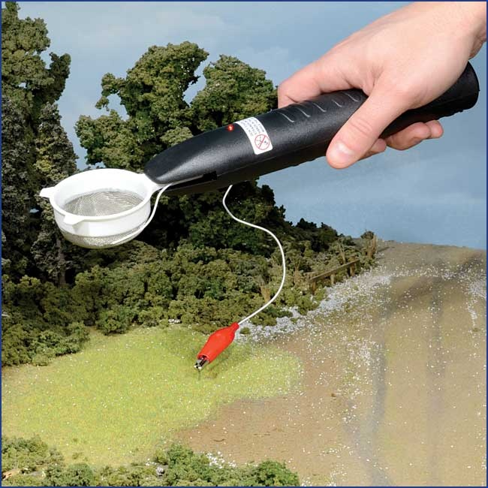
Buy OR build??
MICRO-MARK
Economy Static Grass Applicator by Grass Tech USA
Item #: 85305
Our Price: $39.95
LOOK
FAMILIAR??

Slide 25
Why buy when you can build your own FOR LESS!!
USE THIS TOOL TO ADD AMAZING GRASS TO YOUR LAYOUT AND ENJOY THE SATISFACTION OF HAVING BUILT THIS INEXPENSIVE TOOL YOURSELF!
MODEL RAILROADING IS TRULY FUN!!

Slide 26
DEMONSTRATION w/ tips & tricks
Place slightly damp paper towels or newspaper around work area to collect loose materials.
Wet area to be “grassed” using tap water with drop of dish soap in a spray bottle. NEVER use alcohol as static charge could set your area on fire!
Matte medium, diluted and full strength white glue will work as adhesive.
Full strength white glue recommended for longer fibers.
DO NOT THROW AWAY mixed sizes and/or colors.
Put in baggie, label MIXED, and use again.
Mixtures add realism.
Use “concentrator”, i.e. funnel, to narrow placement area.
Long fibers may be trimmed using small scissors or nose hair trimmers.
After adhesive dries, fiber color may be modified with spray paint, dry brushing and chalks.
After turning off power, touch alligator clip to strainer to ensure no residual charge. Remove batteries to ensure power is not accidentally turned on!
WARNING: THE STATIC CHARGE BETWEEN THE STRAINER AND THE LONG WIRE IS POTENT AND WILL GET YOUR ATTENTION IF YOU OR SOMEONE YOU LOVE GETS BETWEEN THEM!! DON’T ASK HOW DO I KNOW??

